Slide 1
Estimating Expected Customer Value using sklearn and PySpark
Kaitlyn Stick-Mueller
CIS731 – Kansas State University

Slide 2
Outline
Background & Related Work
Dataset
Data Preprocessing
Building & Evaluating Machine Learning Models
Results & Conclusion

Slide 3
Background
Recognizing which customers are most valuable to a brand improves marketing efficiency and promotes success within the business (Saker et al., 2020)
Predict which customers are most worth marketing to by classifying them as valuable or non valuable
Use customer recency, frequency, and monetary value (RFM) to estimate their valuableness (Murphy, 2024)
Train and test machine learning models to cluster and classify customers

Slide 4
Related Work
Project is inspired by the Analyze Customer Lifetime Value Databricks Solution Accelerator
Utilize What Is Recency, Frequency, Monetary Value (RFM) in Marketing? for background on RFM factors (Murphy, 2024)
Use Customer Lifetime Value Part 1: Estimating Customer Lifetimes for further understanding on importance of customer value within a business (Saker, et al., 2020)
Classification models chosen based on feature importance and management of class imbalances
Investigation into using Logistic Regression, Random Forest Classifier, Decision Tree Classifier, Naive Bayes models

Slide 5
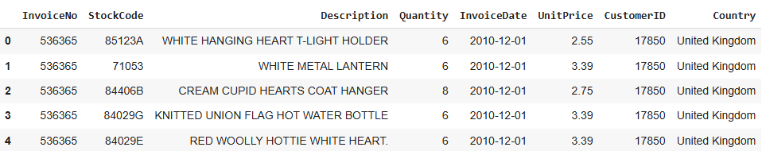
Dataset
Dataset “Online Retail” from UC Irvine Machine Learning Repository, from the Databricks Solution Accelerator
One year of transaction data from a UK based online store (12/1/2010-12/3/2011)
541,909 rows of items purchased, as well as their Invoice Number, Customer Identity, and pricing
Dataset is unlabeled
First five rows of dataset, presented as a Pandas DataFrame

Slide 6
Methodology –Databricks Comparison
Databricks Solution Accelerator | Project Methodology
Clean data by removing customers with null customer IDs and with excessively large purchases | Clean data by removing customers with null customer IDs and with excessively large purchases
Calculate metrics Frequency, Recency, Monetary Value, and Age using BTYD Libraries | Calculate metrics Frequency, Recency, Monetary Value manually using PySpark
Train BetaGeo model to predict purchases of customers in future based on metrics | Cluster customers using PySpark ML models to group customers as valuable or less valuable
Train GammaGamma model to prediction of customer spending in future based on metrics | Classify customers using clustering labels to predict valuableness of customer
Calculate numerical value for Customer Lifetime Value to determine value of each customer from models | Review classification results to estimate factors of valuable and non valuable customers

Slide 7
Data Preprocessing
Changing InvoiceDate from a string data type to a Date data type
Create Sales column: Quantity * UnitPrice
Some cleaning required, including removal of null CustomerID, customers with extremely large daily purchases (+70,000 in 1 day)
Utilize PySpark functions like WithColumn, filter
After processing data, 4227 unique customers available for analysis

Slide 8
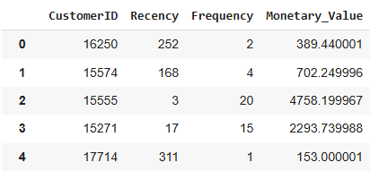
Data Preprocessing Cont’d
Calculating various metrics for each unique CustomerID:
Recency: time since last purchase
Frequency: number of unique invoices
Monetary Value: how much each customer spends
Scale data using MinMaxScaler
Create vector of scaled and unscaled RFM features using VectorAssembler for use in clustering and classification
Split data into train and test sets (70/30)
First five rows of the customers and their metrics, presented in a Pandas DataFrame

Slide 9
Machine Learning Models
Goal is to group customers by valuableness, and accurately predict their value in classification
Trained and tested 4 total PySpark ML models: 2 for clustering and 2 for classification
Clustering models:
K-Means
Bisecting K-Means
Classification models
Logistic Regression
Random Forest Classifier
Split the data into train and test data sets (70/30), once for clustering, and again for classification

Slide 10
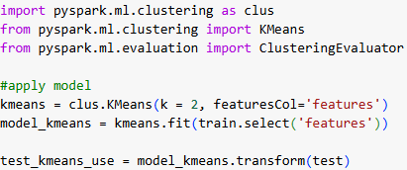
Model Building – K-Means Clustering
Build baseline cluster model, K-Means model, using 2 clusters (valuable and non valuable customers) and default parameters
Train data: 2982 customers (70%)
Test data: 1294 customers (30%)
Evaluation:
Silhouette of 0.858
Model run time: 55.29 seconds
PySpark code for K-Means model

Slide 11
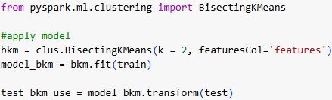
Model Building – Bisecting K-Means Clustering
Build alternative clustering model, Bisecting K-Means model, using 2 clusters (valuable and non valuable customers) and default parameters
Train data: 2982 customers (70%)
Test data: 1294 customers (30%)
Evaluation:
Silhouette of 0.858
Run time: 29.93 seconds
PySpark code for Bisecting K-Means model

Slide 12
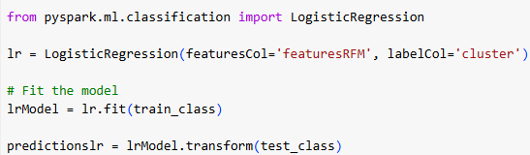
Model Building – Logistic Regression Classification
Build baseline classification model, Logistic Regression model, using labels determined by the K-Means clustering model on the test dataset and default parameters
Train: 926 customers (691 valuable)
Test: 368 customers (281 valuable)
PySpark code for Logistic Regression model
Model Evaluation
Precision | Recall | F1-Score | Support (1) | Support (0) | Run Time | Correct classifications
1.000 | 1.000 | 1.000 | 281 | 87 | 49.14s | 368/368

Slide 13
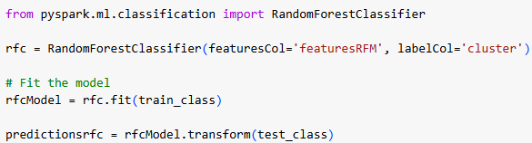
Model Building – Random Forest Classifier
Build alternative classification model, Random Forest Classifier, using labels determined by the K-Means clustering model on the test dataset and default parameters
Train: 926 customers (691 valuable)
Test: 368 customers (281 valuable)
PySpark code for Random Forest Classifier model
Model Evaluation
Precision | Recall | F1-Score | Support (1) | Support (0) | Run Time | Correct classifications
0.993 | 1.000 | 0.996 | 281 | 87 | 47.09s | 366/368

Slide 14
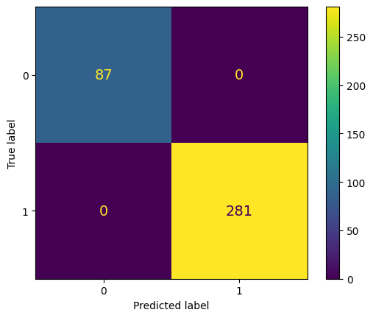

Confusion Matrices for Classification
Logistic Regression Model
Random Forest Classifier Model

Slide 15
Evaluation of Classification Models by Hypothesis Testing
Null hypothesis: The alternative model, Random Forest Classifier, does not outperform the baseline model, Logistic Regression.
Alternative hypothesis: The alternative model, Random Forest Classifier, outperforms the baseline model, Logistic Regression.
Using 3-fold cross validation of F1 score results, obtain p-value of 0.239 (> 0.05)
F1 Scores using 3-fold Cross Validation
Logistic Regression | Random Forest Classifier
1.0000 | 0.9980
1.0000 | 0.9955
1.0000 | 1.0000
Cannot reject null hypothesis at 95% confidence level
Thus, the alternative model, Random Forest Classifier, does not outperform the baseline model, Logistic Regression

Slide 16
Results
K-Means and Bisecting K-Means models acted very similarly
Same silhouette score, bisecting slightly faster run time
Selected K-Means as preferred model to use in classification due to performance success: less prone to run failures
Logistic Regression model and Random Forest Classifier models acted very similarly
From hypothesis testing, cannot reject the null hypothesis, and the models do not outperform each other
Possible inflation of accuracy in Classification models
Model built after clustering model
Limited amount of data: inclusion of more customers or larger time scale

Slide 17
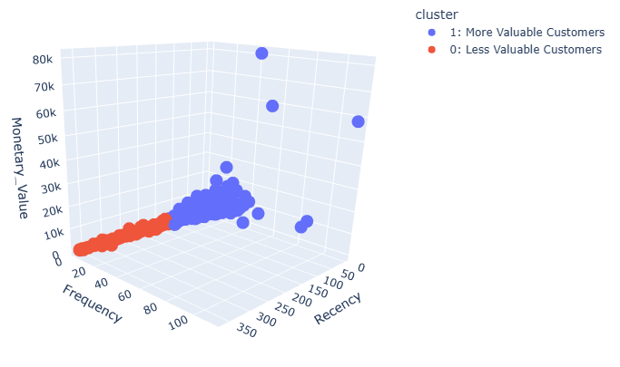
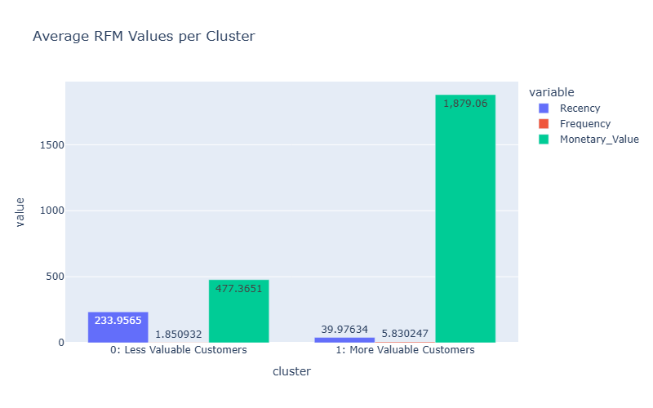
Conclusions
Valuable customers: lower recency, higher frequency, higher monetary value
Non valuable customers: higher recency, lower frequency, lower monetary value
Classification models rank features in terms of importance by (1) recency, (2) frequency, and (3) monetary value

Slide 18
Discussion & Further Work
MOST CHALLENGING ASPECT:
Model building, testing, and evaluating: limited experience, especially in PySpark
ASPECT OF MOST LEARNING:
Importance of understanding your data, how to deal with unlabeled data
FUTURE WORK:
Tuning and testing same and different clustering models,
Increasing size of dataset to have more time or customers available to analyze,
Find numerical quantity for Customer Lifetime Value to determine the true most valuable customers

